Slide 1
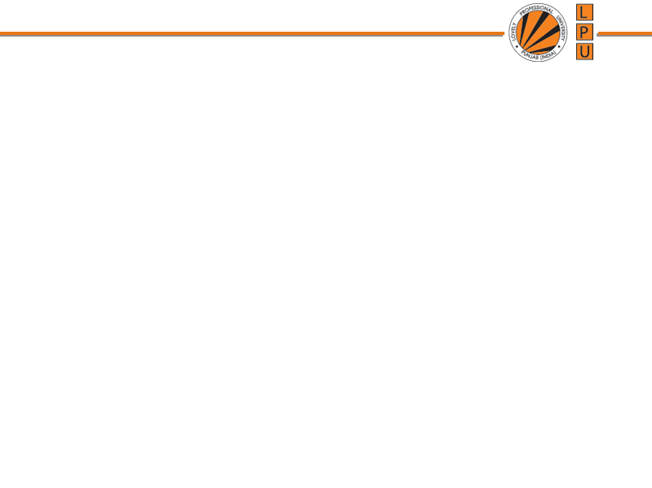
Practical #5
SOFT COMPUTING
LABORATORY
INT518

Slide 2
12/12/14
CSE510, Lovely Professional University, Phagwara
Q1. Write a python program to classify iris data using SVM
Q2. Write a python program to predict iris data using SVM kernel linear function
Q3. Write a python program to cluster the random data using SVM
Q4. Write a python program to implement Fuzzy union operation.
Q5. Write a python program to implement Fuzzy Intersection operation.
Q6. Write a python program to implement Fuzzy complement operation.

Slide 3

12/12/14
CSE510, Lovely Professional University, Phagwara

